Slide 1
Notes to Presenter
This is a one-hour pd. (If you can get 75 minutes, it will give you some flexibility with time in case you determine some slides need additional time.) The SPF 2.0 and Multi-media Project Presentation is not included. There will be two separate 30 minute pds to cover these topics.
This powerpoint should not be presented if teachers have not taught Start Smart 1.0.
You will be using 3rd grade lessons to train all teachers..
For this pd, you need:
  Start Smart 2.0 Outline – Grades 2-5 for all teachers
  Start Smart 2.0 Outline –Grades K-1 for K-1 teachers to give at the end of the presentation (very similar to Grade 2-5)
  3rd lesson 1-6 for all teachers
  Give One Get One Graphic Organizer
  Lesson Resources for PD
  Timeline/Outline of 3 Lesson Series & Frame of Practice

Slide 2
Start Smart 2.0
Notes:
Slides 2-8 16 minutes
30 seconds on this slide
Welcome participants.

Slide 3

Grounding
What does it mean
to listen for understanding?
Turn & Talk
Notes:
Slides 2-8 16 minutes
2 minutes
Have teachers turn and talk regarding the prompt.
Have two or three participants share out.

Slide 4
start smart 2.0
Unit Outline
Notes:
Slides 2-8 16 minutes
30 seconds
We are now going to spend sometime looking at the Start Smart 2.0 Outline for 2nd through 5th grade.
Please inform K-1 teachers that you will pass out the outline for K-1 to them at the end of the pd. Their outline is very similar to the 2-5, but with modifications considering the needs of K-1 students.

Slide 5
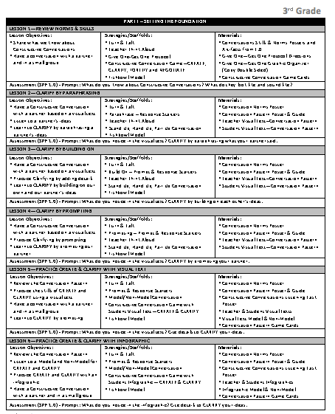
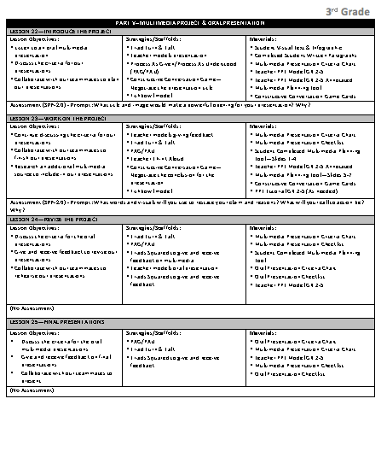
Start Smart 2.0
Outline, Gr. 2-5
Pull pages apart
Scan Part I and Part V
  What do you notice?
  What do you wonder?
Turn & Talk
Notes:
Slides 2-8 16 minutes
4 minutes
Give your teachers 2 minutes to look over the outline, 1 minute to discuss with their partner their noticings and wonderings and 1 minute for a share out.
Call attention to Part 1 (pg.1) and the emphasis on skill of Clarify. The subskills of Clarify are introduced and practice in lessons 2-4.
Note to Presenter: MMED is not creating SS 2.0 lessons for 6th grade. Secondary will be doing this at a later point for 6th grade.

Slide 6
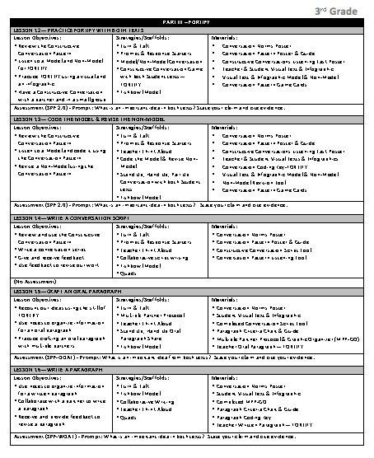
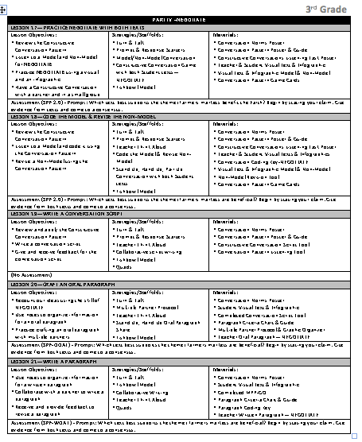
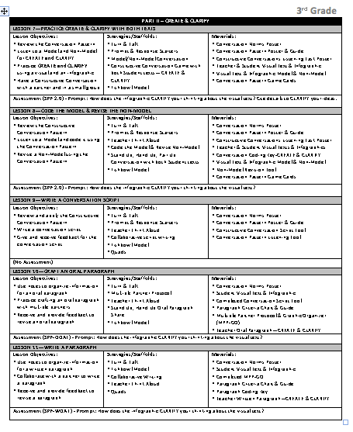
Start Smart 2.0
Outline, Gr. 2-5
Now scan Parts II,III, and IV
  What do you notice?
  What do you wonder?
Turn & Talk
Notes:
Slides 2-8 16 minutes
3 minutes
Give your teachers 1 minute to look over the outline, 1 minute to discuss with their partner their noticings and wonderings and 1 minute for a share out.
Pages 2, 3 and 4 have the same layout. Teachers should identify there is a pattern within the unit the only thing that changes on pages 2,3, and 4 are the skill taught.

Slide 7
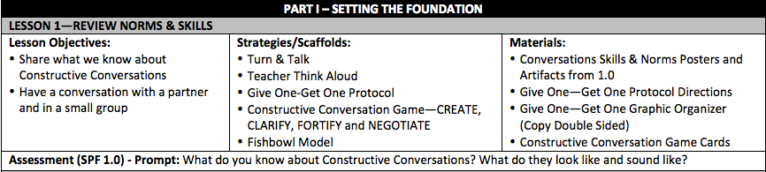
Start Smart 2.0
Lesson Treasure Hunt
For example:
p. 9
p. 9
9
p. 11
Notes:
Slides 2-8 16 minutes
4 minutes
Give teachers an opportunity to engage in a Lesson Treasure Hunt.
They should look at Lesson 1 and have them identify with a partner on what page they found evidence of the “focus”, “scaffold” or “material”.
Use the animations to share some of the page numbers.

Slide 8
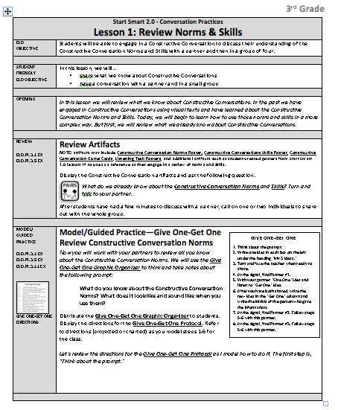

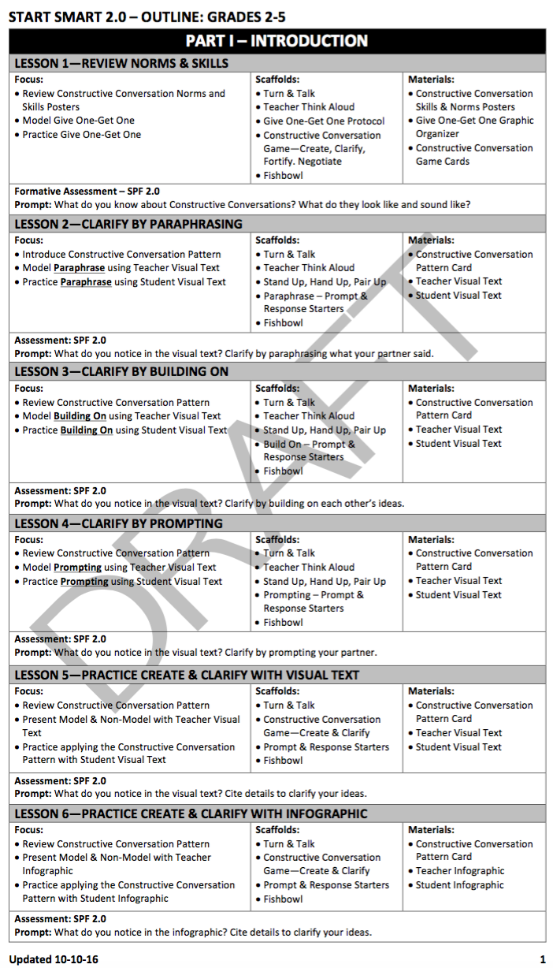
Start Smart 2.0
Lesson Treasure Hunt
Turn & Talk
How does Start Smart 2.0 build on the work of 1.0?
Notes:
Slides 2-8 16 minutes
2 minutes
Teachers will engage in a turn and talk around the question posed.
Have a couple of participants share out.

Slide 9
Start Smart 1.0 Revised | Start Smart 2.0
August - September 15 Lessons | November – December 25 Lessons
Constructive Conversation Skills Skills taught in isolation | Constructive Conversation Skills Paraphrasing is emphasized Create and Clarify together
Visual Texts | Visual Texts Info Graphics
SPF | SPF 2.0
Code Models Revise Non-Model | Code Models Revise Non-Model Graphic Organizer
Oral Presentation of Poster | Oral Presentation & PPT
Notes:
Slides 9-12 5 minutes
1 minute
Acknowledge that the teachers have completed teaching 1.0.
Touch upon some of the similarities and key differences that they will learn more about as they dig into Start Smart 2.0.

Slide 10
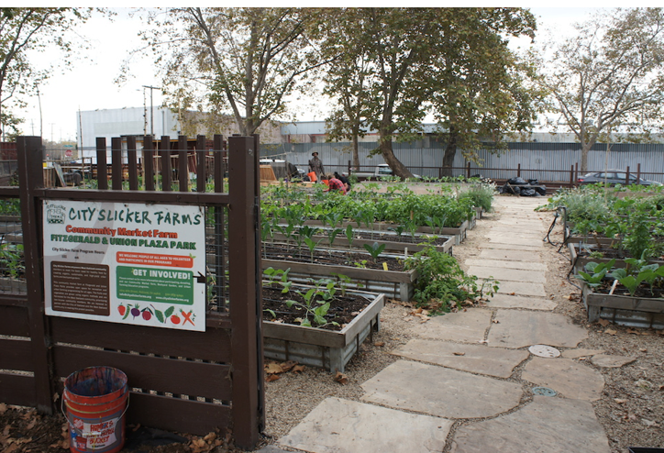

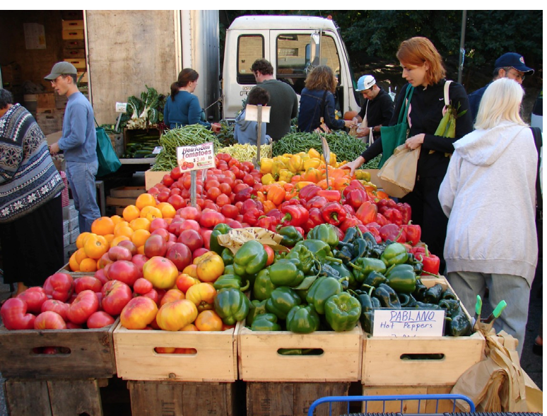
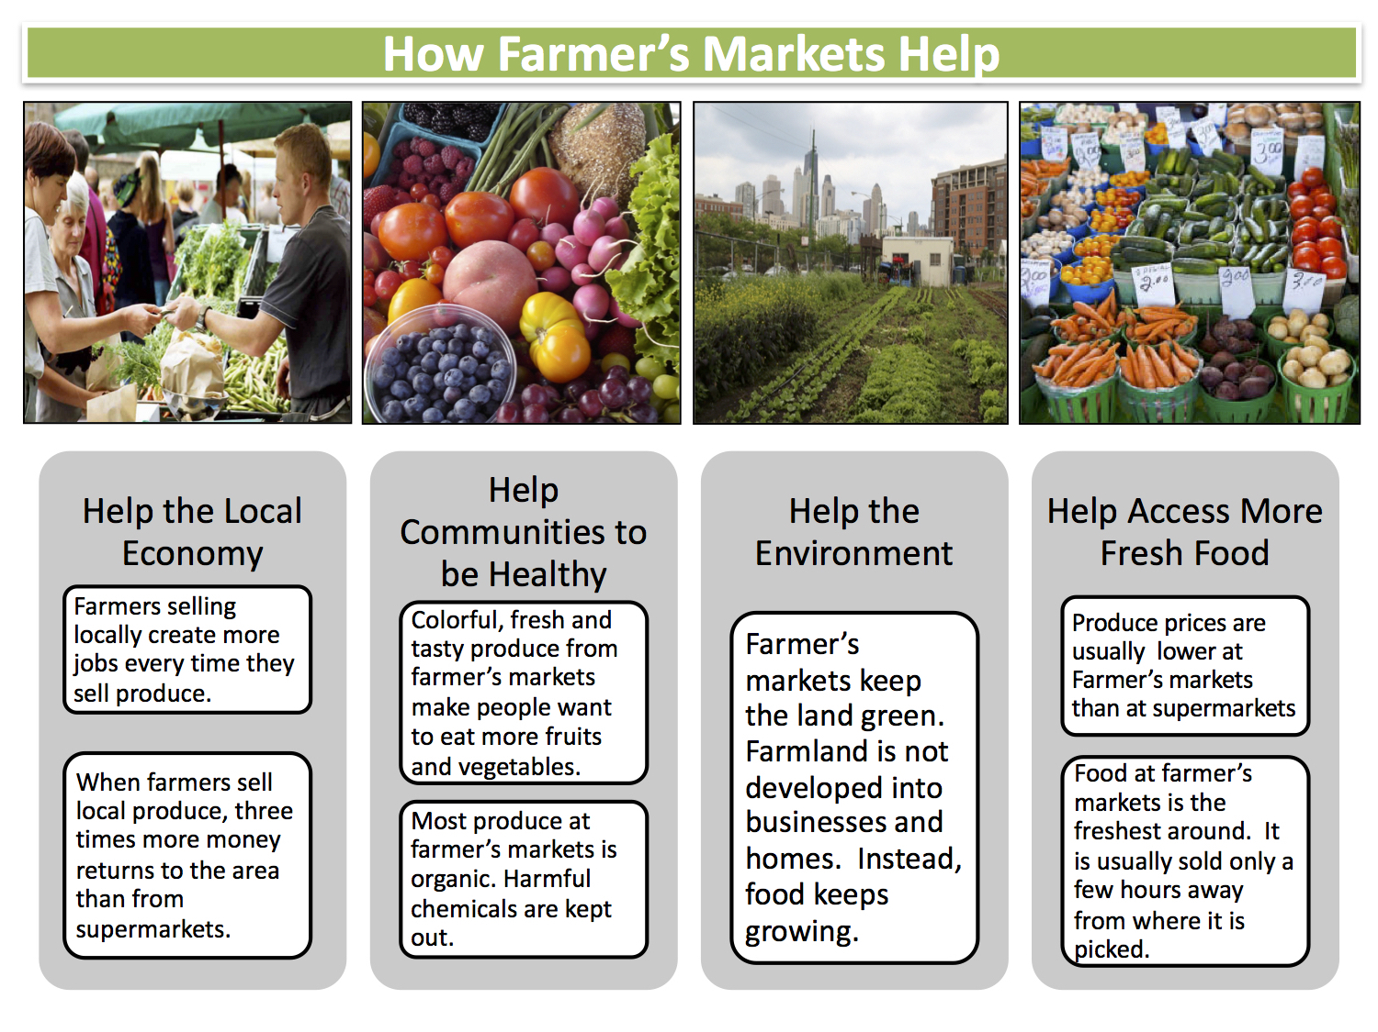
SS 2.0 Analyze and Discuss Visual and Infographic Texts
CREATE and CLARIFY
PROMPT: What do you notice in the visual text? Cite details to CLARIFY your ideas.
PROMPT: How does the infographic CLARIFY your thinking about the visual text?
Visual Text and Infographic Text
-Teacher Set
FORTIFY
PROMPT: What is an important idea in both texts? State your claim and cite evidence.
NEGOTIATE
PROMPT: Which text best support the theme:
Farmers markets are beneficial? Begin by stating your claim. Cite evidence from both texts and come to a consensus.
Visual Text and
Infographic-Student Set
Notes:
Slides 9-12 5 minutes
2 minutes
Let participants know that Start Smart 2.0 connects to Smarter Balanced State Test:
The test presents ” 2 or 3 stimuli” from which the student draws information to formulate a response. In Start Smart 2.0 students are presented with two texts: a visual text and an infographic.
Let participants know that the two texts used in Start Smart 2.0 bridge ELs into using Dual Text Stimuli: 1. Visual Text (complex text) and 2. Infographic (Graph and other features i.e. visuals, charts, boxes, tables, etc. that provide additional information for speaker and reader to reference).
Say:
• The teacher uses the same texts throughout the lessons to continue building on the understanding of the themes and ideas represented in the texts. The students use a different text set to practice the Constructive Conversation Skills.
• Both text sets are aligned to either the Social Studies or the Next Generation Science Standards. However, these lessons are not designed to teach content standards but to develop complex oral output (academic and disciplinary language).
Let participants know that the skills of CREATE and CLARIFY are used together to begin also apprenticing the students to use the Constructive Conversation Skills in a more fluid manner. The skills of FORTIFY and NEGOTIATE are practiced separately for the students to be able to analyze and discuss evidence from both texts and make inferences and draw conclusions.

Slide 11
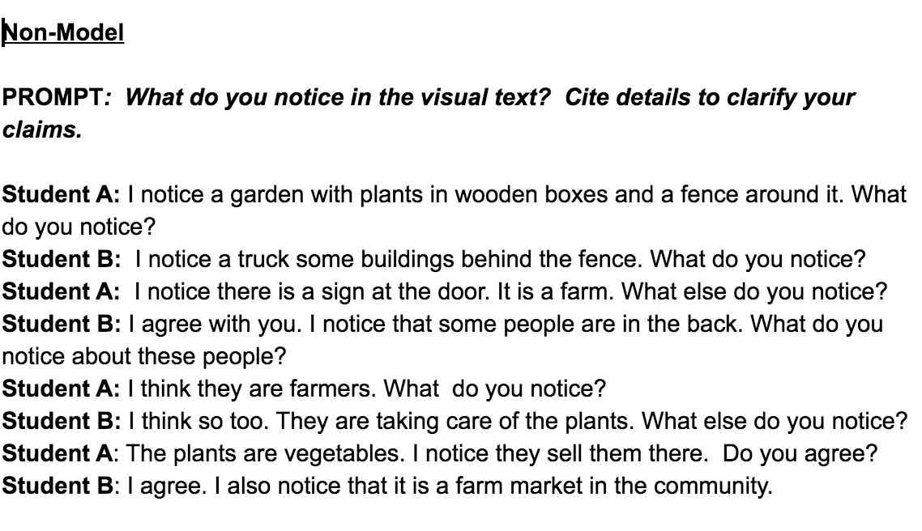
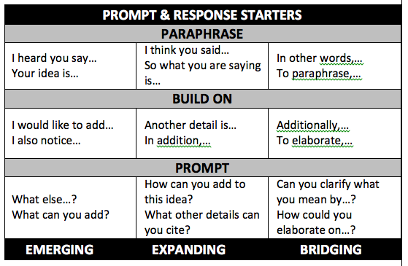
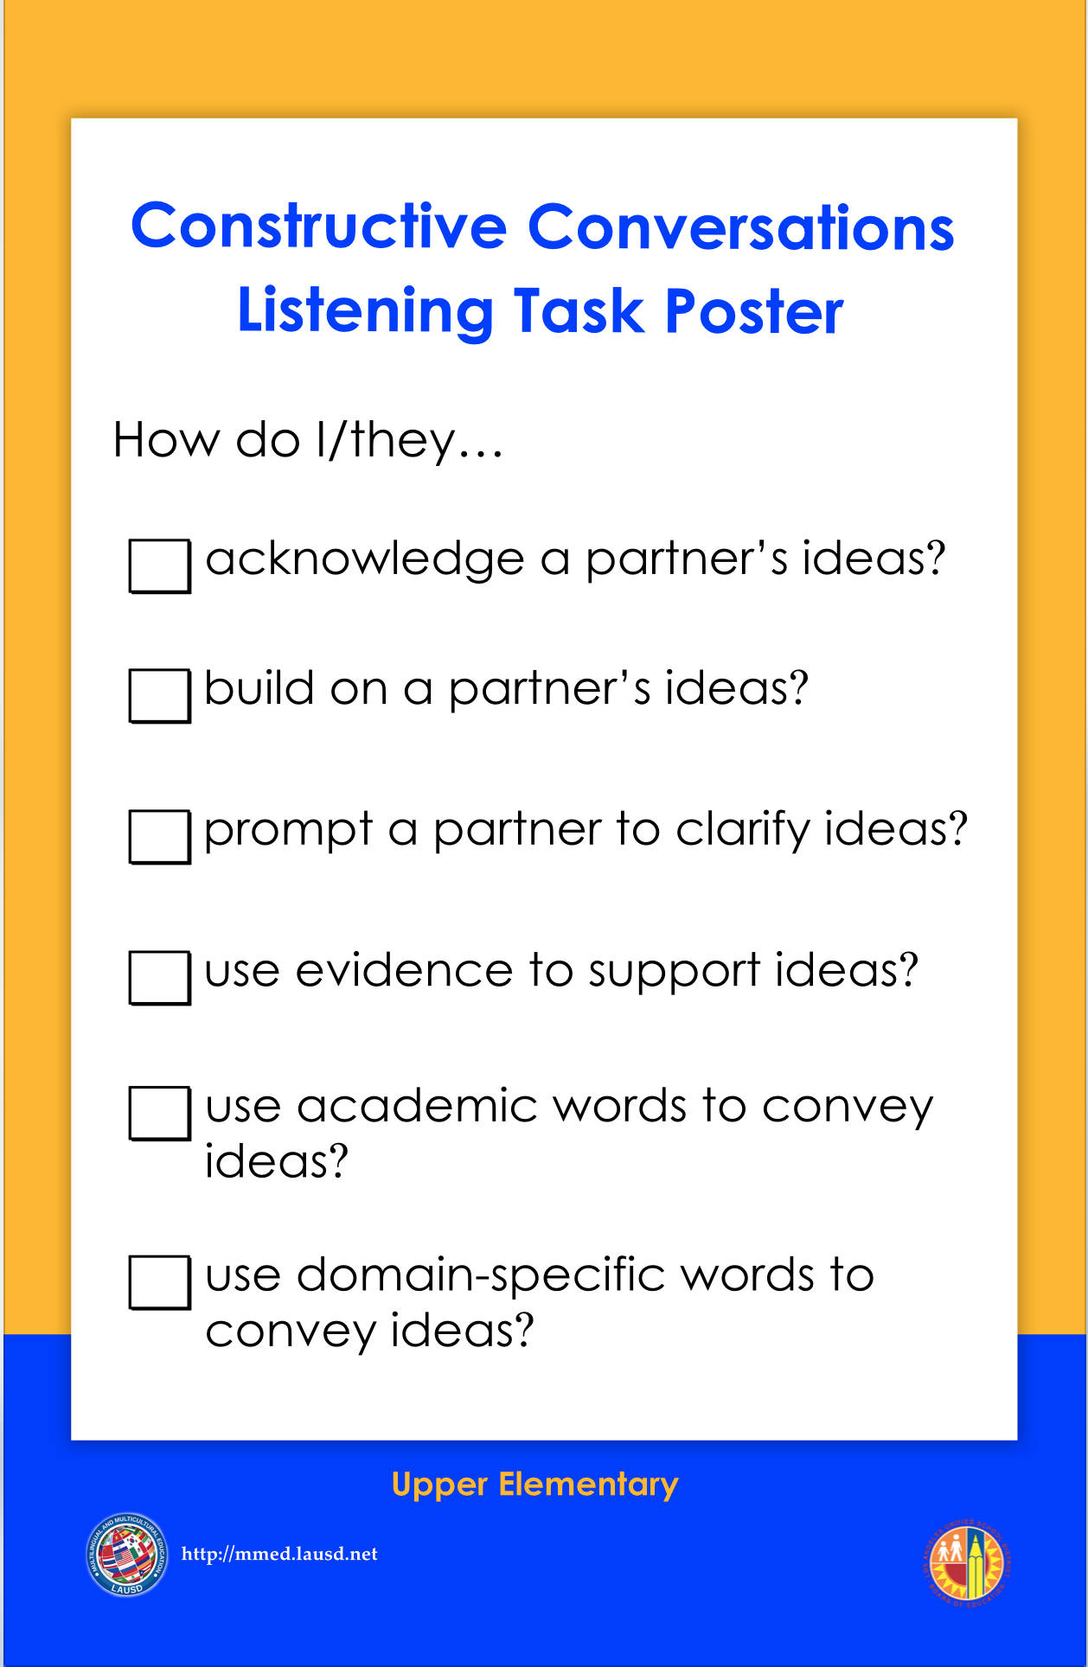
SS 2.0 Non-Model Conversation-Revise
Teacher:
  Models metacognitive processes to review Non-Model Conversation
  Refer to the Constructive Conversations Listening Task Poster
Students:
  Use metacognitive strategies to review Non-Model Conversation
  Use the Constructive Conversations Listening Task Poster and Constructive Conversations Prompt/Response Starters Charts
Notes:
Slides 9-12 5 minutes
1 minute
Say:
The Non-Model Conversation will be used to foster metacognition. Teacher will explicitly model the analysis of what makes a Non-Model Conversation.
Teacher will use the prompt and response starters according to the language of the skill as well as the new Constructive Conversation Listening Task Poster to guide the analysis of the Non-Model Conversation.
Teacher gradually releases the responsibility of using metacognitive strategies to the students.
Let the participants know that the new Constructive Conversation Listening Task Poster synthesizes the Norms and the Skills. It also refers to the use of academic and domain specific language.

Slide 12
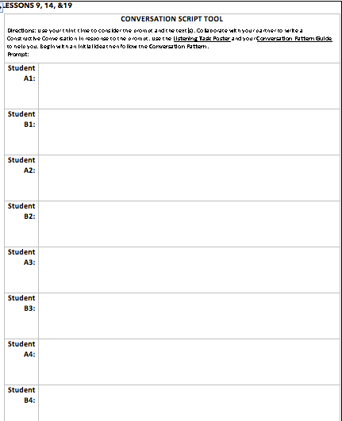
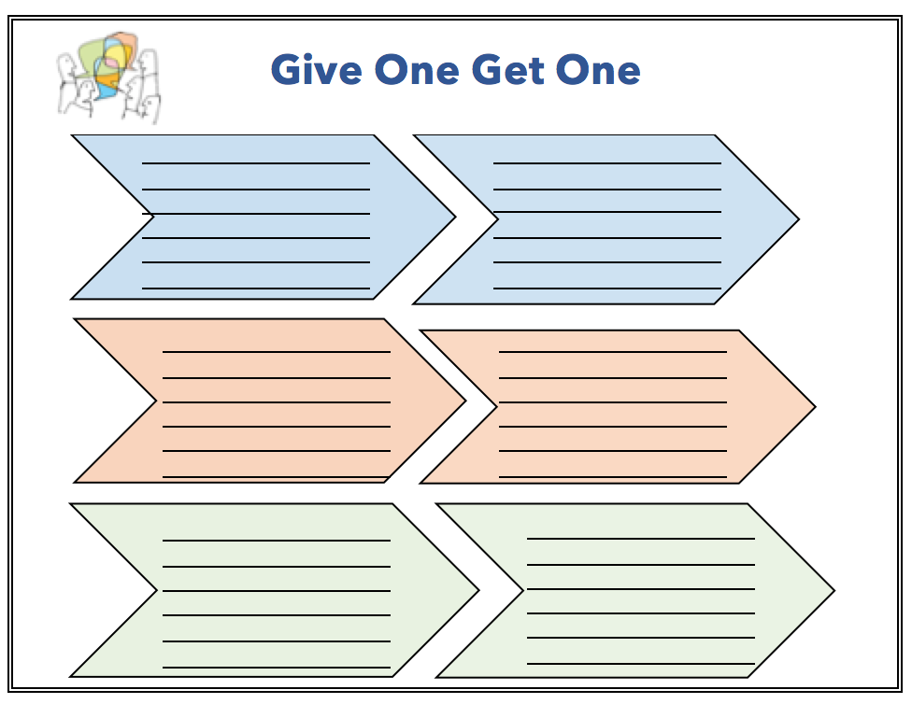
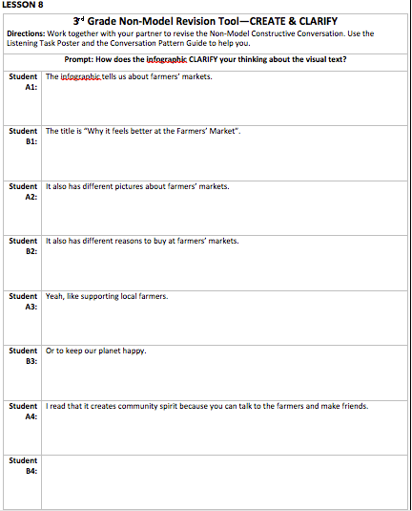


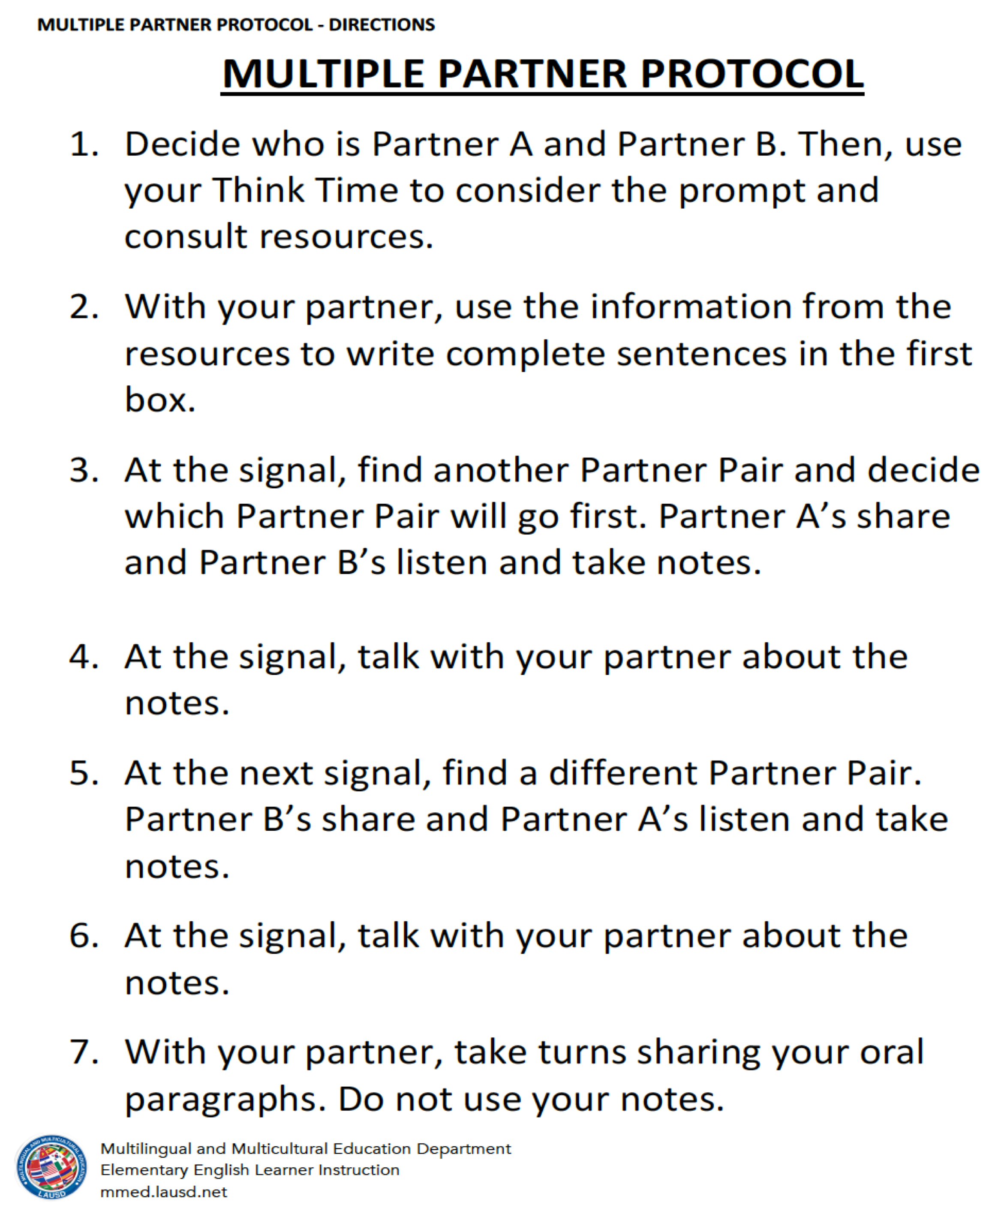
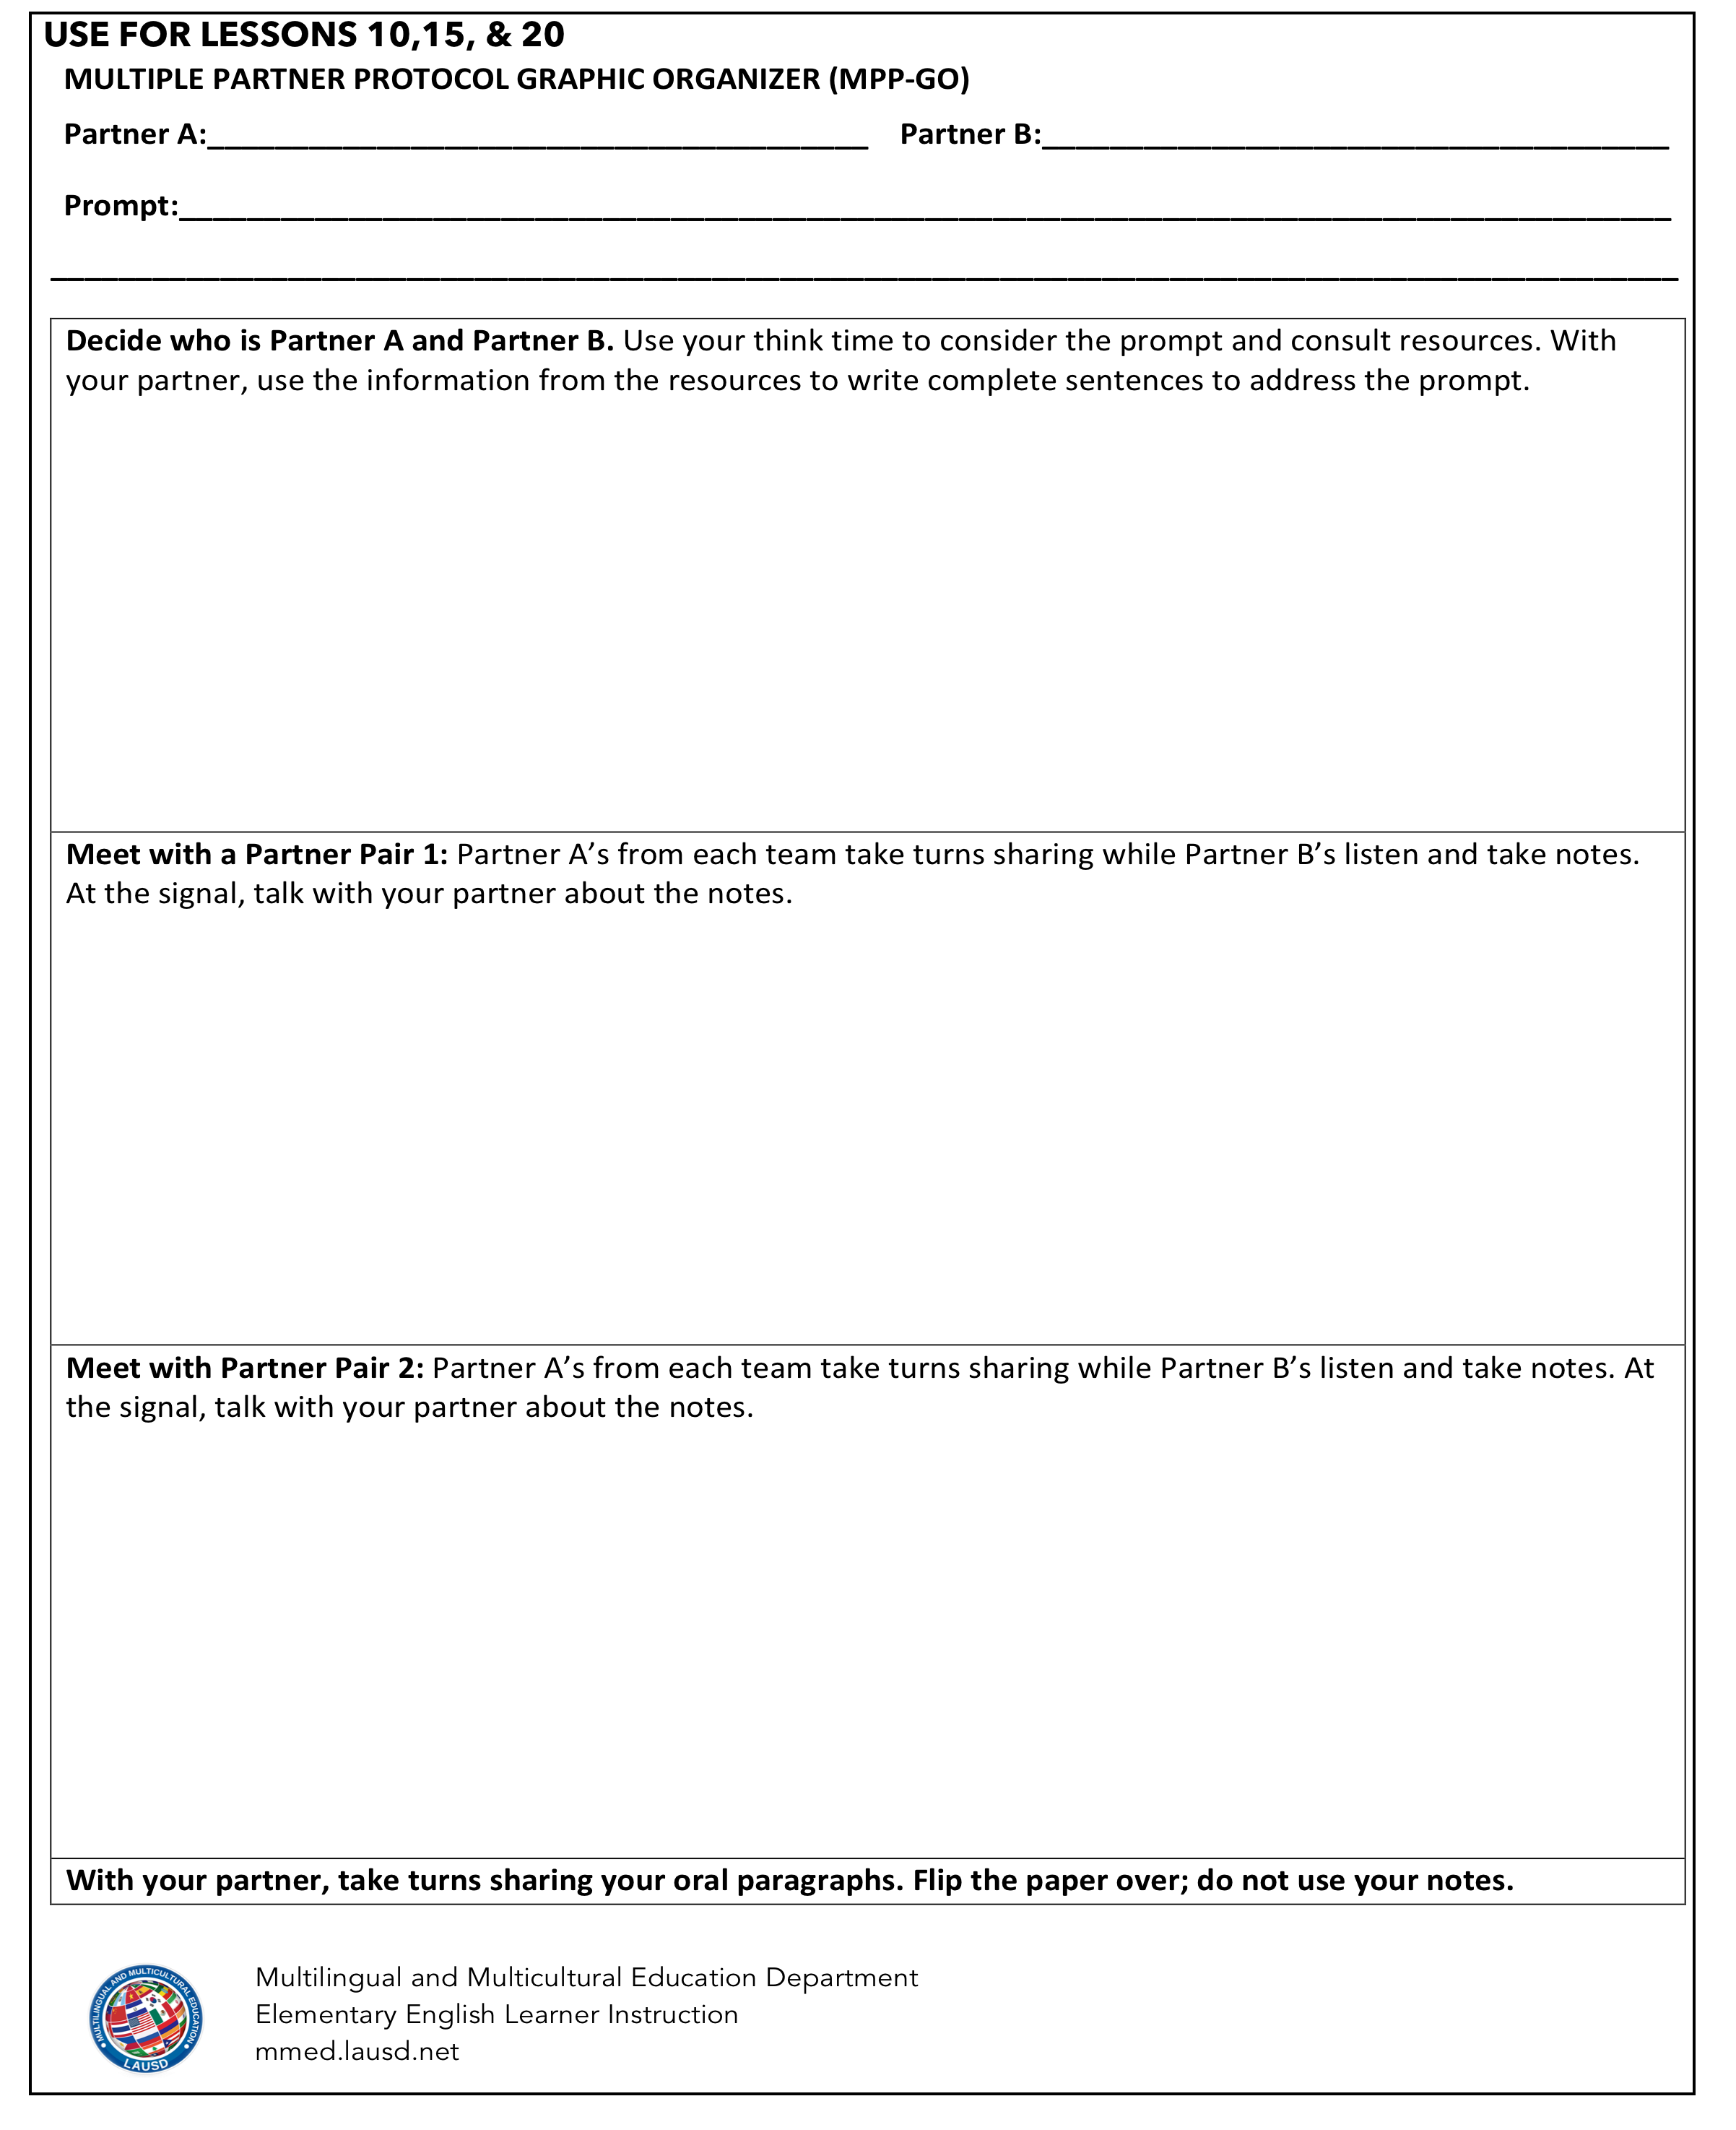
SS 2.0 & Writing
Teacher models how to use graphic organizers
Students use graphic organizers to write with diverse partners
  Gr.K-2 Shared Writing
  Gr.3-5 Joint Writing
Notes:
Slides 9-12 5 minutes
1 minute:
Let participants know that:
• Writing is supported in lessons by means of using graphic organizers. Students take notes as they think and prepare for a conversation.
• In addition to the use of graphic organizers, ELs will engage in Shared Writing in Primary Grades (K-2) or in Collaborative Writing in Upper Grades (3-5). They write Constructive Conversations in collaboration with teacher and peers.

Slide 13
start smart 2.0
Lesson Dig-In
Notes:
Slides 10-22 30 minutes
30 seconds
We are transitioning now into an opportunity to dig into the lessons. We will be looking at the first key lessons for 3rd grade.

Slide 14
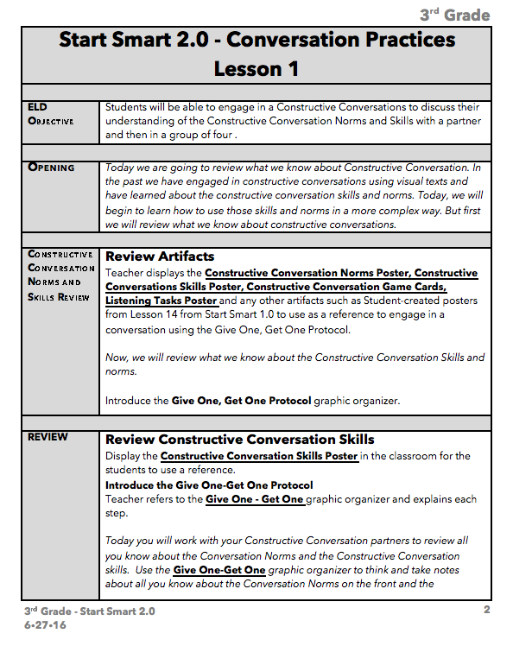
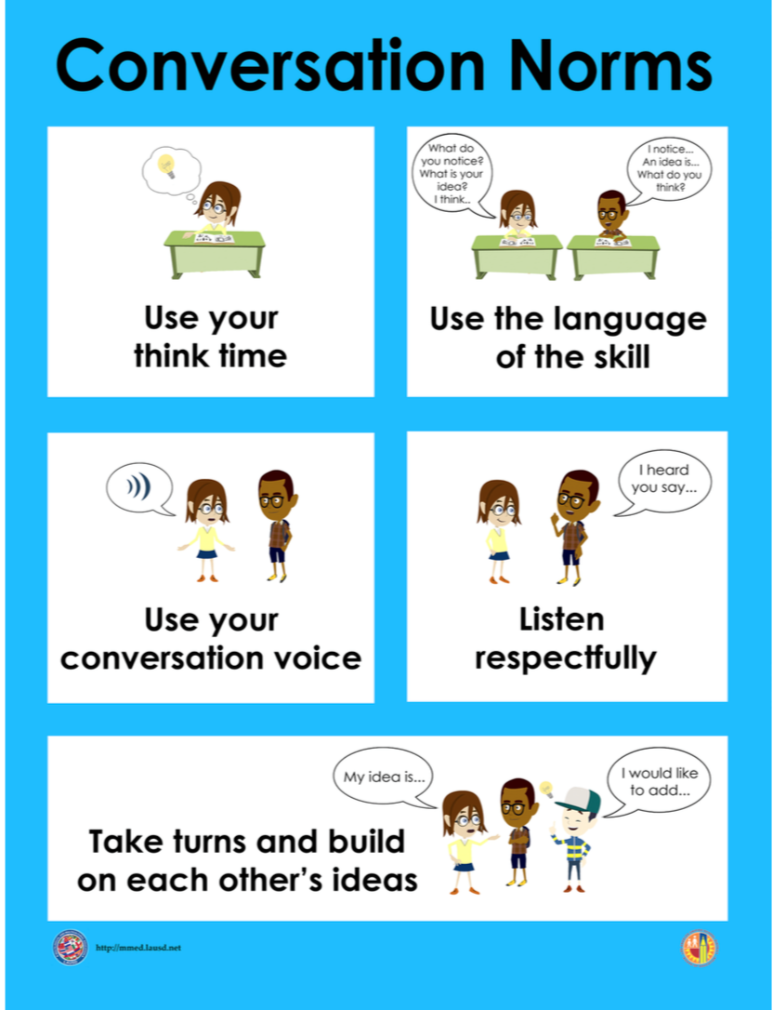
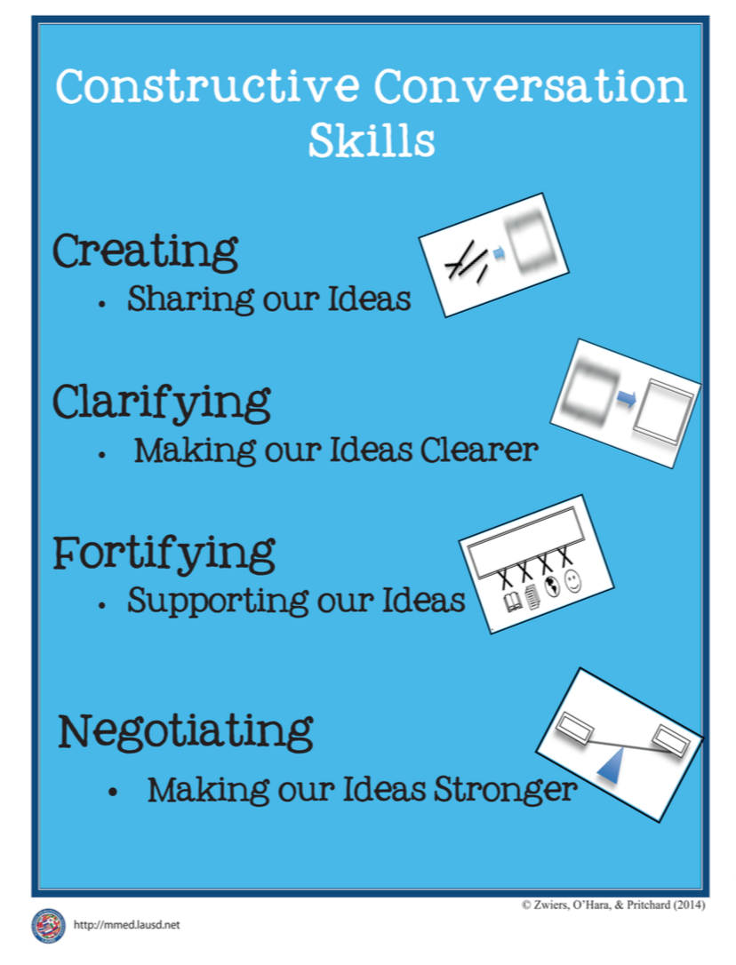

LESSON 1
REVIEW NORMS & SKILLS
Browse: Lesson 1 p. 9-12
  Circle the standards in the margin on each page of this lesson.
Prompt: What do you know about the Conversation Skills? What does it look like and sound like when you use them?
Key Strategy: Give One, Get One p. 9-10
Notes:
Slides 10-22 30 minutes
6 minutes
Give teachers 2 minutes to browse Lesson 1.
Share the prompt that is used during Lesson 1.
Explain the Give One, Get One Strategy (See chart on page 2 of the lesson.)
Have teachers engage in the Give One, Get One Strategy using the provided graphic organizer. (They need to share with people not at the table they were sitting at. Have them stand up to meet with people from other tables.)
Have a couple of participants share out.

Slide 15
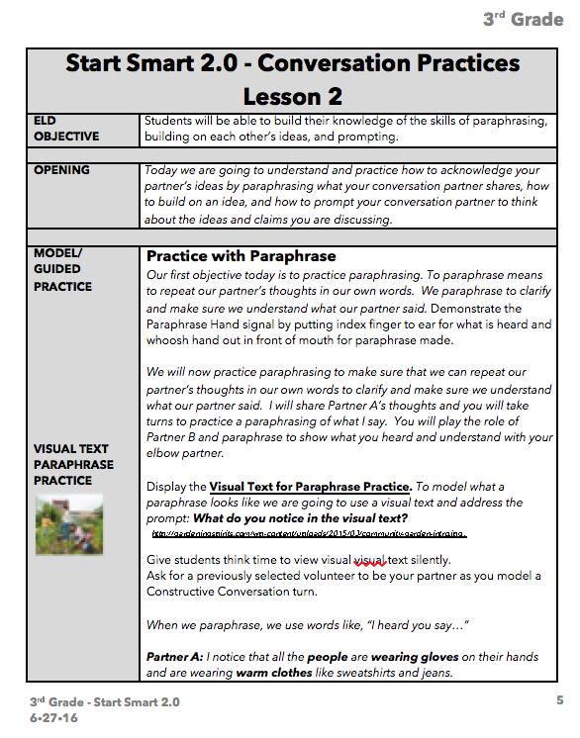
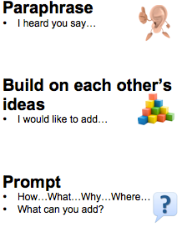
LESSON 2
CLARIFY BY PARAPHRASING
Browse: Lesson 2 pages 13-17
  Circle the standards in the margin on each page of this lesson.
Prompt: What do you notice in the visual text? Clarify by paraphrasing what your partner said.
Key Strategies:
Paraphrase
Conversation Pattern
Stand Up, Hand Up
Notes:
Slides 10-22 30 minutes
6 minutes (Slides 15-16)
Give teachers 2 minutes to browse Lesson 2.
Share the prompt that is used during Lesson 2 and reference them to the first clarifying skill on the Conversation Pattern Card (handout).
Explain the Stand Up, Hand Up protocol (Reference the instructions on the top of page 8 of the lesson.)
Display the Visual Text on Slide 16 and have participants engage in a Constructive Conversation including the skill of paraphrasing to clarify in their conversation.

Slide 16

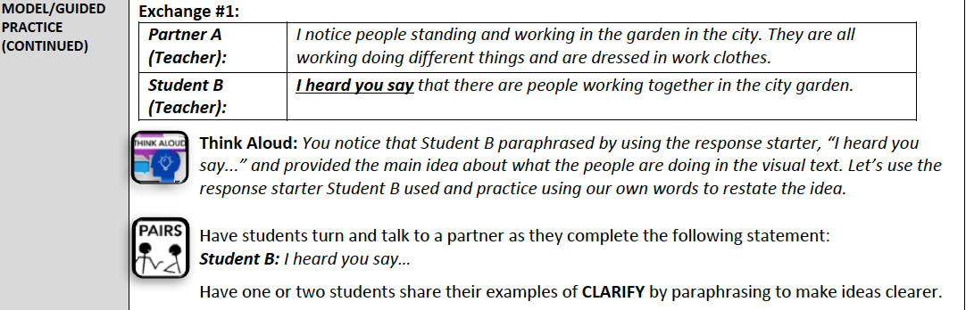
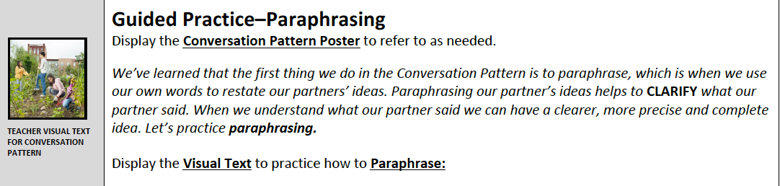
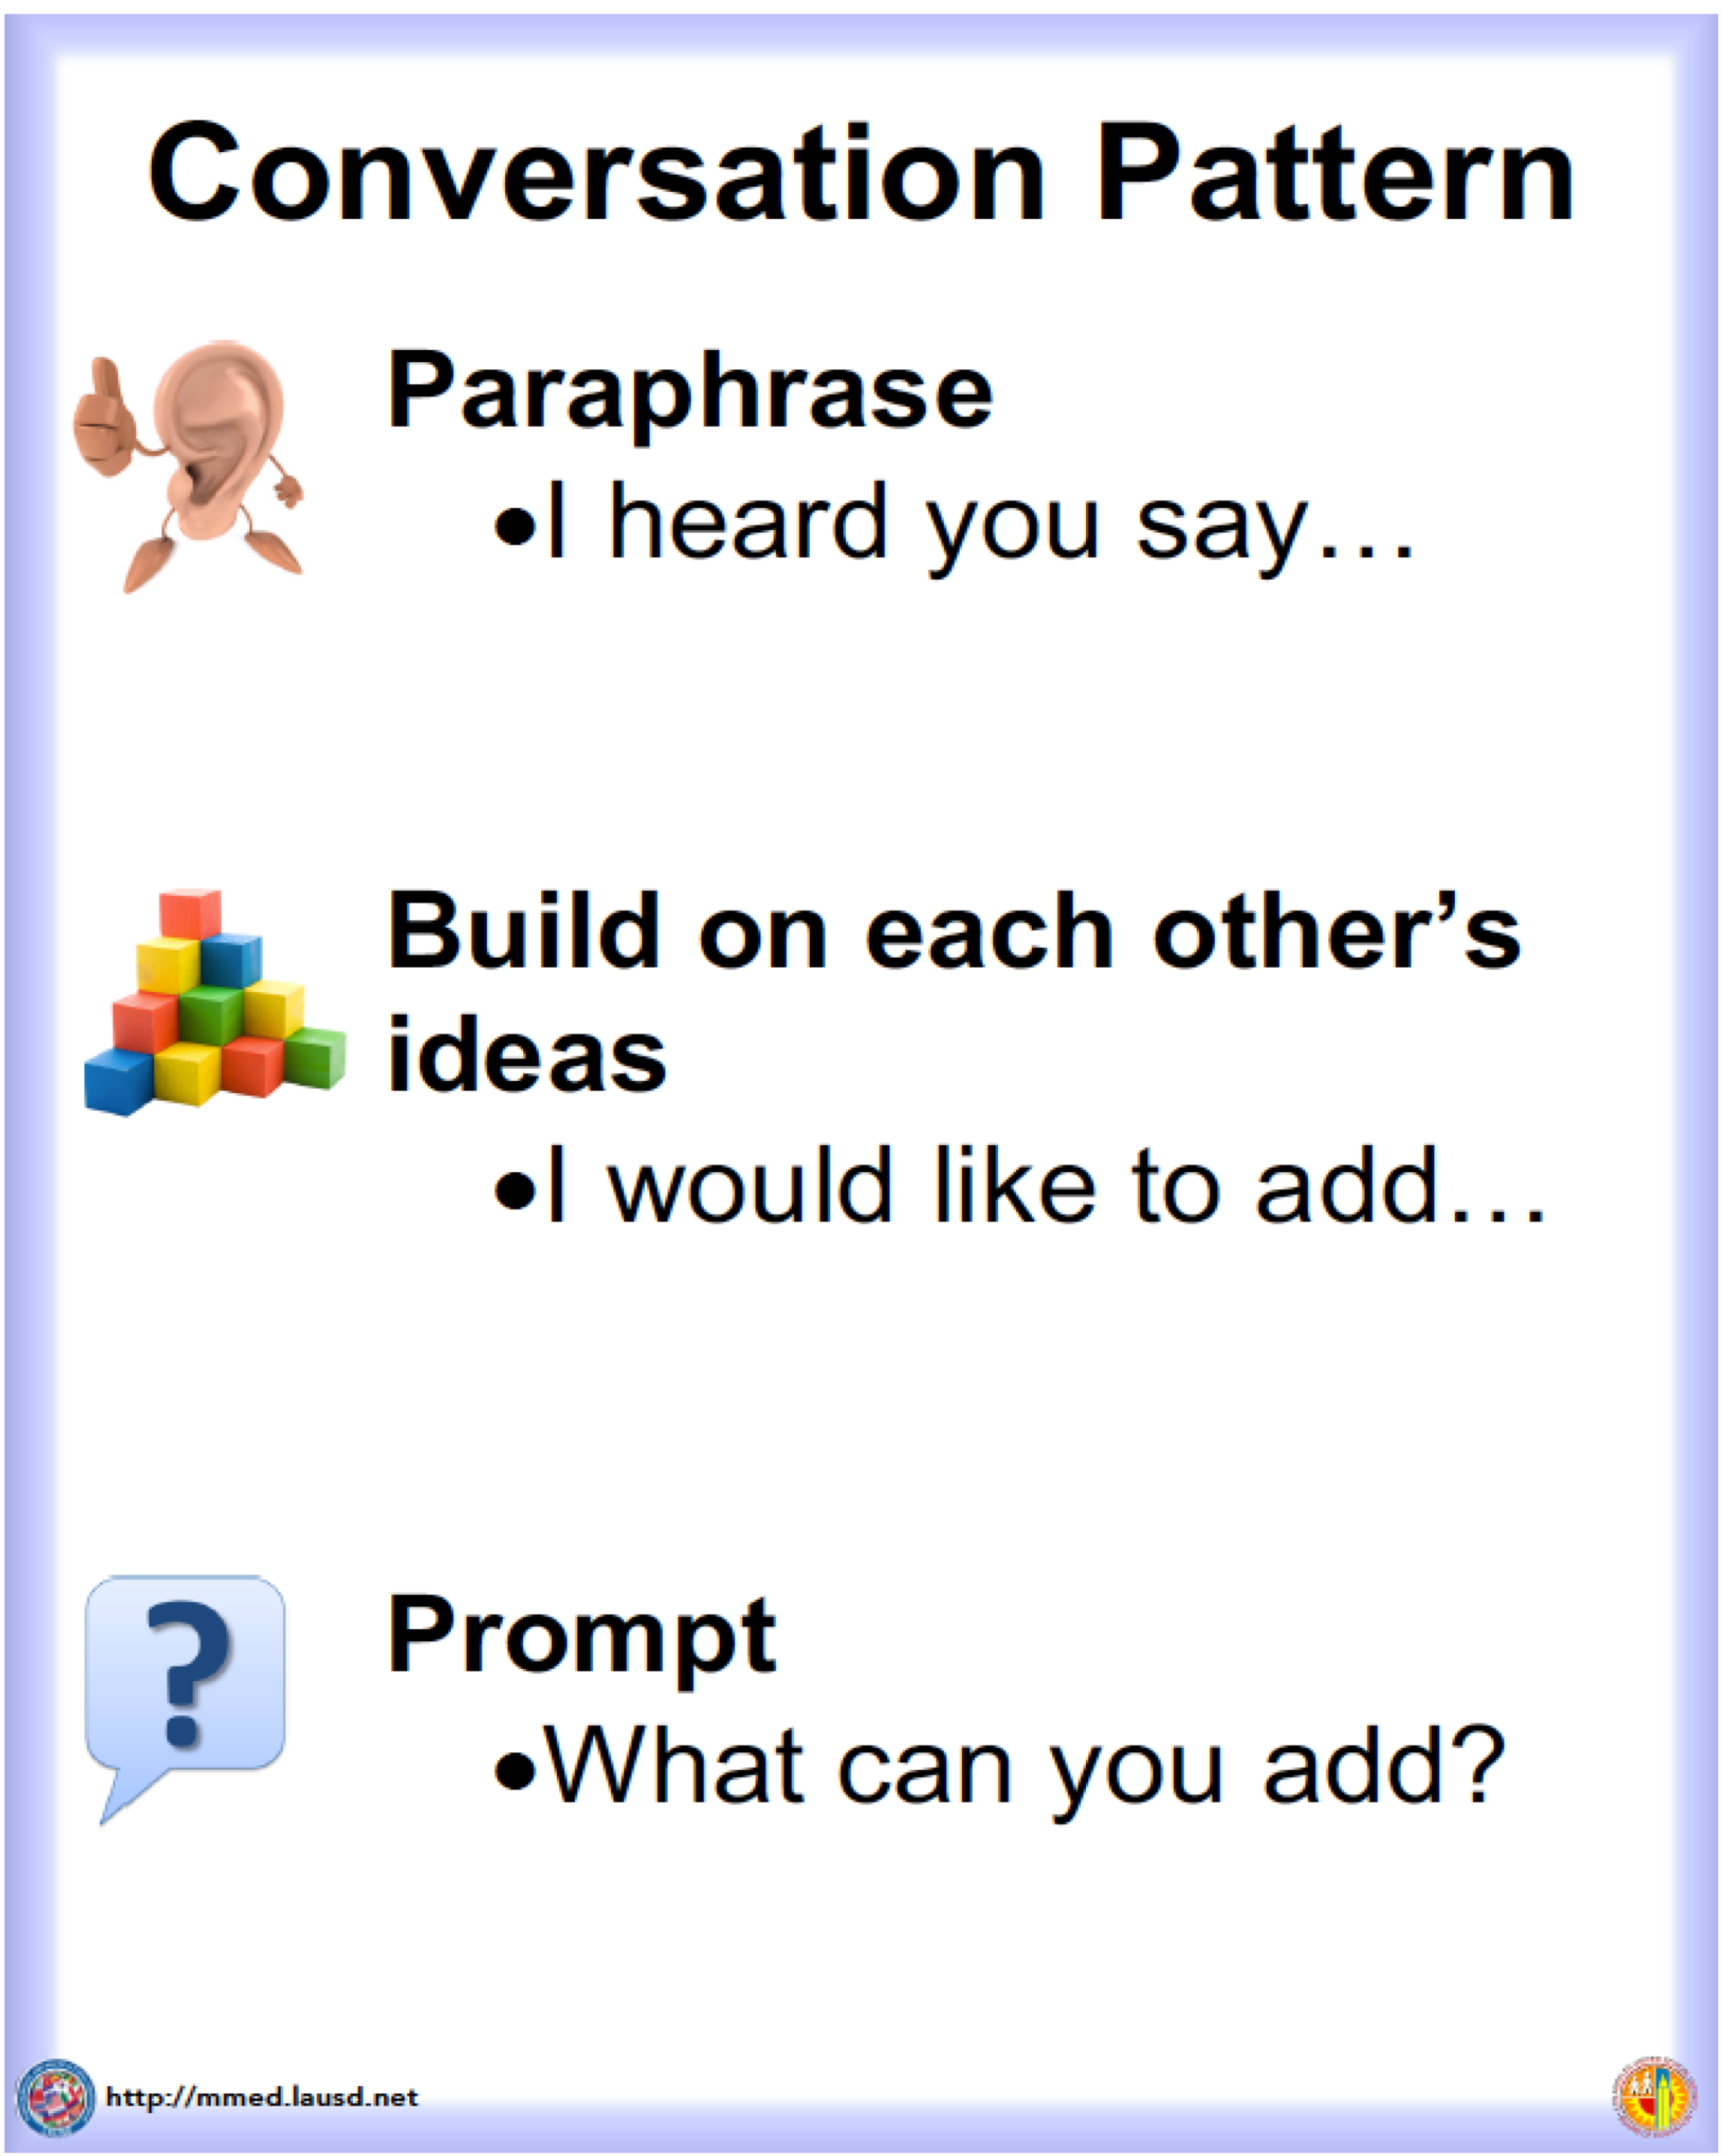
Notes:
Slides 10-22 30 minutes
Slides 15-16
Display this visual as the participants are engaging in “paraphrasing” as they respond to the prompt on slide 15.

Slide 17

Stand Up, Hand Up, Pair Up

Slide 18
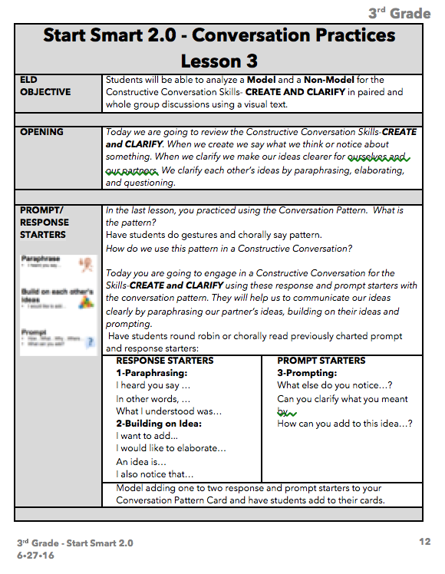
LESSON 3
CLARIFY BY BUILDING ON
Browse: Lesson 3 pages 18-22
  Circle the standards in the margin on each page of this lesson.
Prompt: What do you notice in the visual text? Clarify by building on each other’s ideas.
Key Strategies:
Building On
Conversation Pattern
Stand Up, Hand Up
Notes:
Slides 10-22 30 minutes
6 minutes (Slides 17-18)
Give teachers 2 minutes to browse Lesson 3.
Share the prompt that is used during Lesson 3 and reference them to the second skill on the Conversation Pattern Card (handout).
Use the Stand Up, Hand Up protocol for participants to find a Constructive Conversation partner who they have not spoken with before.
Display the Visual Text on Slide 18 and have participants engage in a Constructive Conversation including the skill of building on each other’s ideas in their conversation.
NOTE TO PRESENTER: In the lesson you will see that the teacher models using both paraphrasing and building on in “Exchanges 1 and 2”. However, the focus for student practice (Exchange 3 and 4) and Constructive Conversation is the new skill of “building on each other’s ideas.”

Slide 19
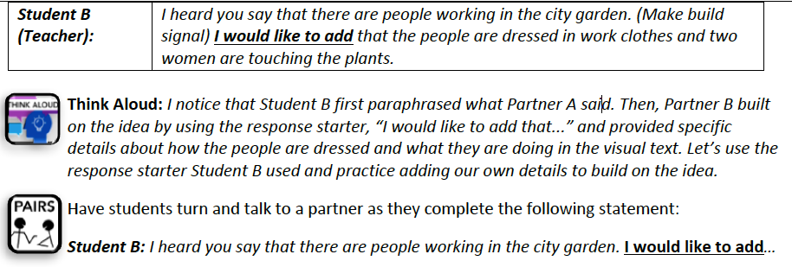
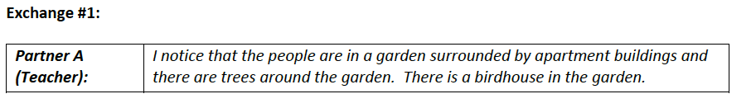
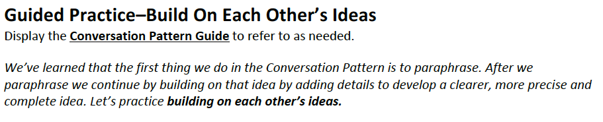
Notes:
Slides 10-22 30 minutes
Slides 17-18
Display this visual as the participants are engaging in “building on” as they respond to the prompt on slide 17.

Slide 20
Stand Up, Hand Up, Pair Up

Slide 21
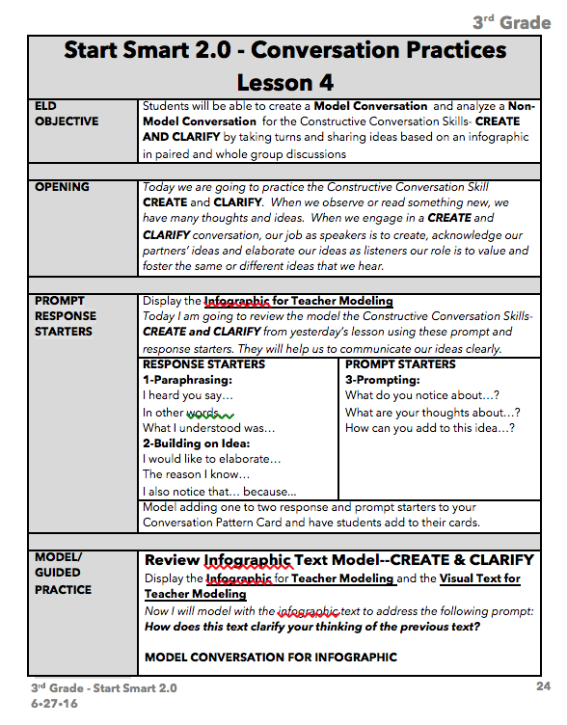
LESSON 4
CLARIFY by PROMPTING
Browse: Lesson 4 pages 23-27
  Circle the standards in the margin on each page of this lesson.
Prompt: What do you notice in the visual text? Clarify by prompting your partner.
Key Strategies:
Prompting
Conversation Pattern
Stand Up, Hand Up
Notes:
Slides 10-22 30 minutes
6 minutes (Slides 19-20)
Give teachers 2 minutes to browse Lesson 4.
Share the prompt that is used during Lesson 4 and reference them to the third skill on the Conversation Pattern Card (handout).
Use the Stand Up, Hand Up protocol for participants to find a Constructive Conversation partner who they have not spoken with before.
Display the Visual Text on Slide 20 and have participants engage in a Constructive Conversation using the skill of prompting in their conversation.
NOTE TO PRESENTER: In the lesson you will see that the teacher models using both paraphrasing, building on and prompting in “Exchanges 1 and 2”. However, the focus for student practice (Exchange 3 and 4) and Constructive Conversation is the new skill of “prompting.”

Slide 22
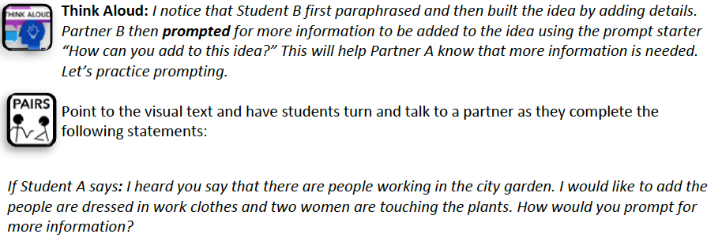
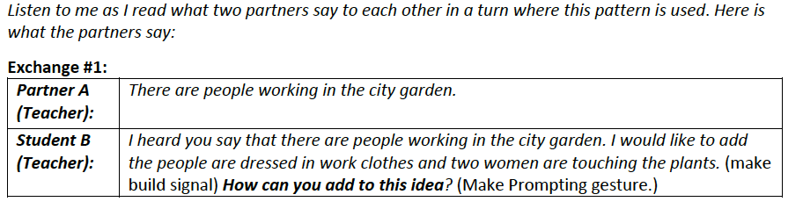
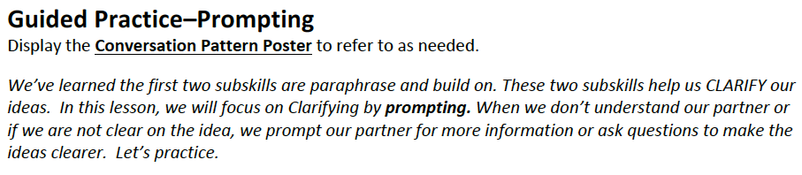
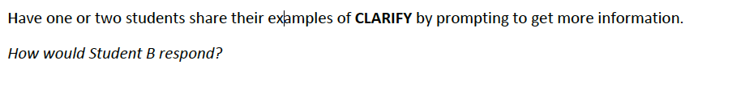
Notes:
Slides 10-22 30 minutes
Slides 19-20
Display this visual as the participants are engaging in “prompting” as they respond to the prompt on slide 19.

Slide 23
Stand Up, Hand Up, Pair Up

Slide 24
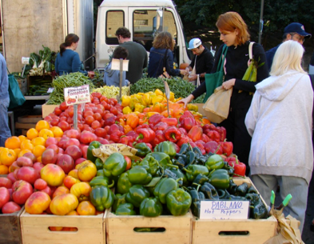
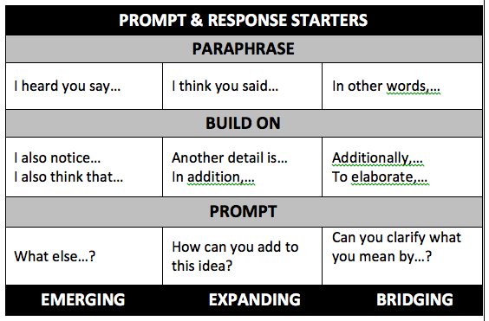
LESSON 5
PRACTICE CREATE & CLARIFY
WITH VISUAL TEXT
Highlights:
Prompt and Response Starters (p. 28-29)
Listening Task Poster introduced (p. 29)
Model Conversation includes analyzing for noun phrases to clarify ideas (a Part II Standard) (p. 30)
Debrief Non-Model Conversation to add details using noun phrases (p. 31)
Constructive Conversation Game (p. 31)
Prompt: What do you notice in the visual text? Cite details to clarify your ideas.
Notes:
Slides 10-22 30 minutes
2 minutes
Highlight additional key parts of Lesson 5. (Teachers are not browsing this lesson.)
You can also surface that during this lesson is the first time that the students will be using the conversation pattern (all three skills) in their Constructive Conversations.

Slide 25
LESSON 6
PRACTICE CREATE & CLARIFY
WITH INFOGRAPHIC
Highlights:
Additional Prompt and Response Starters (p. 33-34)
Model Conversation includes analyzing for noun phrases to clarify ideas
  (Part II Standard) (p. 35)
Debrief Non-Model Conversation to add details using noun phrases (p. 35)
Prompts:
What do you notice in the infographic? Cite details to CLARIFY your ideas.
Notes:
Slides 10-22 30 minutes
2 minutes
Highlight additional key parts of Lesson 6. Reiterate what an infographic is. Lesson 6 is the first time students will be introduced to an infographic as part of a Start Smart lesson. (Teachers are not browsing this lesson.)

Slide 26
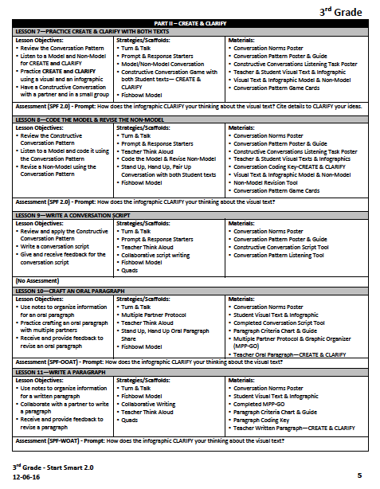
Start Smart 2.0
Outline, Gr. 2-5
Part II- Create and Clarify
  Lesson 7- Practice Create and Clarify with both texts
  Lesson 8- Code the Model & Revise the Non-Model
  Lesson 9- Write a Conversation Script
  Lesson 10- Craft an Oral Paragraph
  Lesson 11- Write a Paragraph
Notes:
Slides 23-26 4 minutes
1 minute
Refer teachers back to page 2 of the outline and review headings to highlight the components of the full unit.

Slide 27
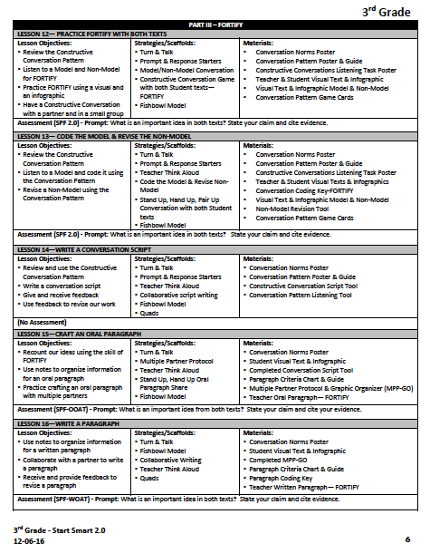
Start Smart 2.0
Outline, Gr. 2-5
Part III- Fortify
  Lesson 12- Practice Fortify with both texts
  Lesson 13- Code the Model & Revise the Non-Model
  Lesson 14- Write a Conversation Script
  Lesson 15- Craft an Oral Paragraph
  Lesson 16- Write a Paragraph
Notes:
Slides 23-26 4 minutes
1 minute
Refer teachers to page 3 of the outline and review headings to highlight the components of the full unit.

Slide 28
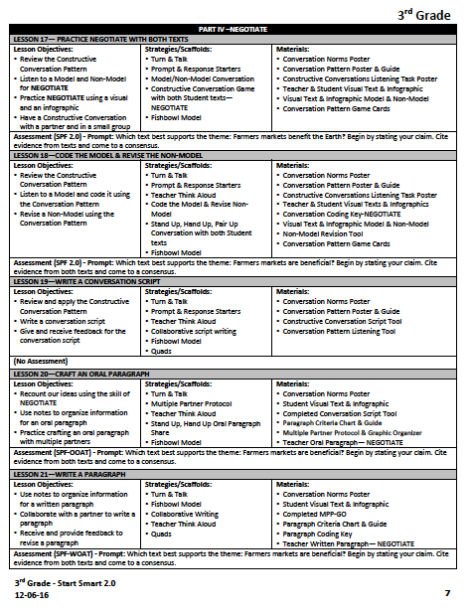
Start Smart 2.0
Outline, Gr. 2-5
Part IV- Negotiate
  Lesson 17- Practice Negotiate with both texts
  Lesson 18- Code the Model & Revise the Non-Model
  Lesson 19- Write a Conversation Script
  Lesson 20- Craft an Oral Paragraph
  Lesson 21- Write a Paragraph
Notes:
Slides 23-26 4 minutes
1 minute
Refer teachers to page 4 of the outline and review headings to highlight the components of the full unit.

Slide 29
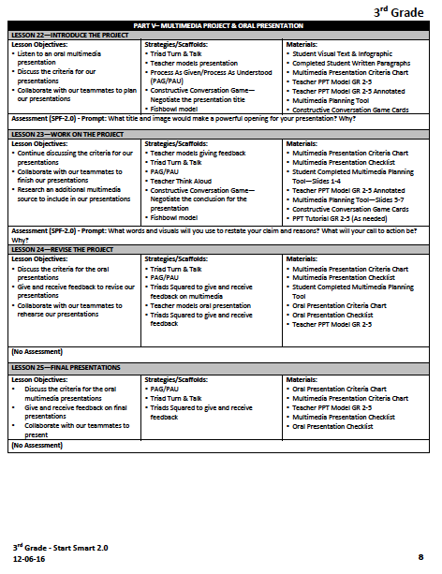
Start Smart 2.0
Outline, Gr. 2-5
Part V- Multimedia Project Presentation
  Lesson 22- Introduce the Multimedia Project
  Lesson 23- Work on the project
  Lesson 24- Revise the project
  Lesson 25- Final Presentations
Notes:
Slides 23-26 4 minutes
1 minutes
Refer teachers to page 5 of the outline and review headings to highlight the components of the full unit.

Slide 30
Reflection
With a conversation partner discuss the following:
  What are your next steps?
Notes:
Slides 23-25 6 minutes
3 minutes
Have teachers turn and talk regarding the prompt.
Have a few participants share out so that you can gauge their ideas of next steps and need for support.

Slide 31
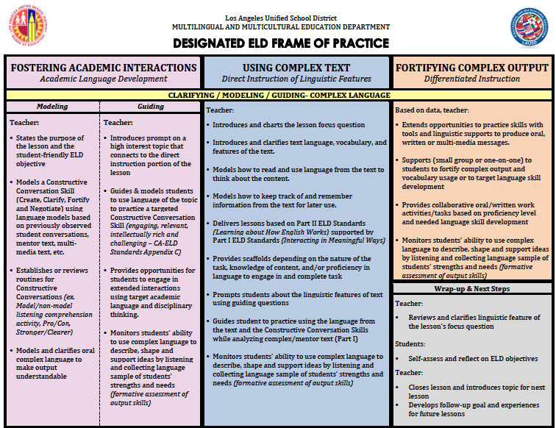
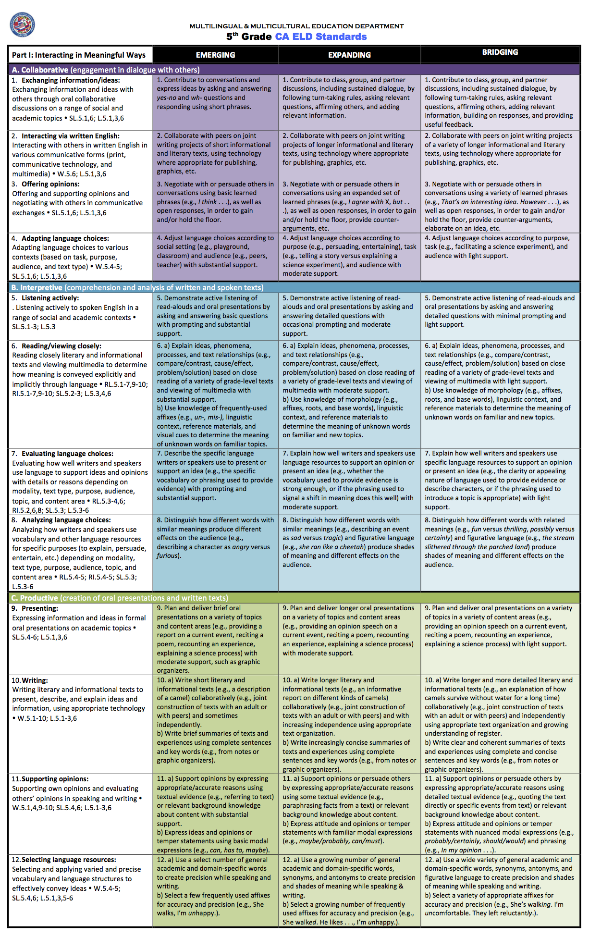
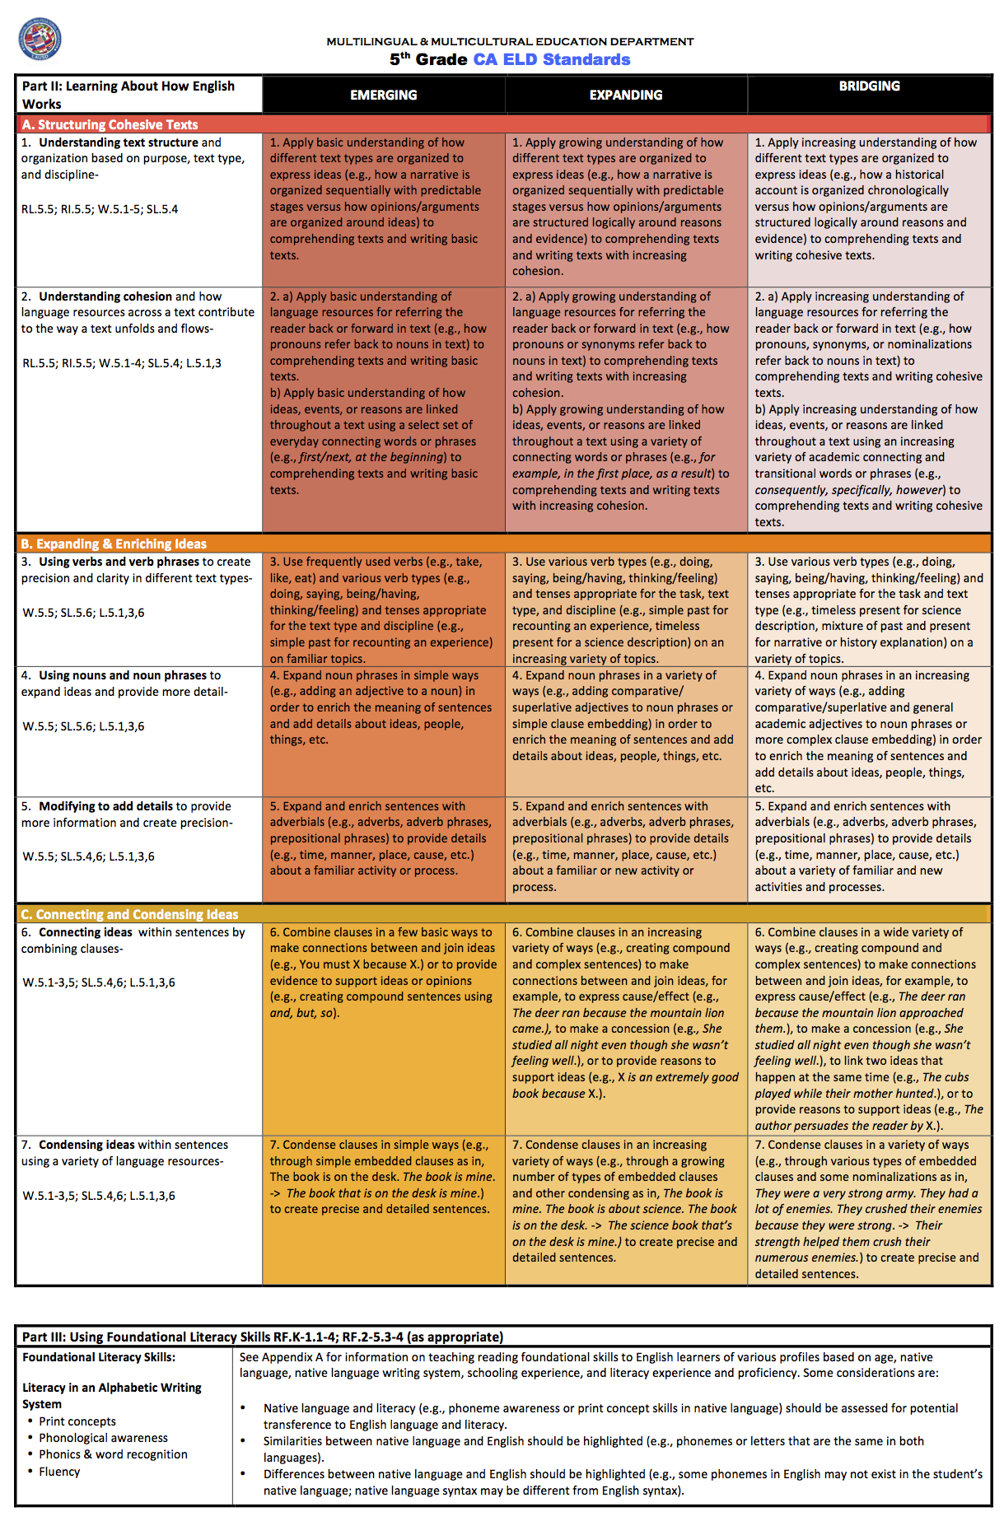
Start Smart 1.0 | Designated ELD Lessons | Start Smart 2.0 | Designated ELD Lessons | Disciplinary Discussions Using Text Sets | Designated ELD Lessons
August/September 15 Lessons | September- October | October/November 25 Lessons | December | January - February 20 Lessons | February - June
Constructive Conversation Skills Skills taught in isolation | Plan and teach lessons using the Designated ELD Frame of Practice* and the CA ELD Standards – Part I & Part II | Constructive Conversation Skills Paraphrasing is emphasized Create and Clarify together | Plan and teach lessons using the Designated ELD Frame of Practice* and the CA ELD Standards – Part I & Part II | Constructive Conversation Skills All CC skills applied | Plan and teach lessons using the Designated ELD Frame of Practice* and the CA ELD Standards – Part I & Part II
Visual Texts |  | Visual Texts Info Graphics |  | Text Sets Multiple Visuals Written Text Audio Text Video
SPF |  | SPF 2.0 |  | SPF 2.0
Code Models Revise Non-Model |  | Code Models Revise Non-Model Graphic Organizer |  | Code Models Graphic Organizers
 |  |  |  | Close Reading
 |  |  |  | Critical Analysis Questions (SBAC)
 |  |  |  | Research and Writing
Oral Presentation of Poster |  | Oral Presentation & PPT |  | Oral Presentation Multimedia Presentation
Notes:
Slides 23-25 6 minutes
3 minutes
The Start Smart 1.0 lessons focus exclusively on Part I CA ELD standards. The Start Smart 2.0 lessons focus primarily on Part I CA ELD standards. That is why they are called Start Smart lessons and NOT Designated ELD lessons.
After Start Smart 1.0 and before the 2.0, teachers must follow the Designated ELD Frame of Practice and the model lessons on the MMED website to design and teach lessons that use grade level complex texts.
Disciplinary Discussions Using Text Sets presents a rigorous approach to Designated ELD. Following these lessons teachers need to return to the Designated ELD Frame of Practice to design and teach lessons that use complex texts and teach both Part I and Part II of the CA ELD standards. When teachers are not teaching this 3 part series of Designated ELD units, they should be following the Designated ELD Frame of Practice to design and teach lessons that focus on Part II standards and continue to develop the skills required by the Modes in Part I of the CA ELD standards.

Slide 32
Thank you for your Participation!
Notes:
Slides 23-25 6 minutes
15 seconds
Thank your participants.

Slide 33
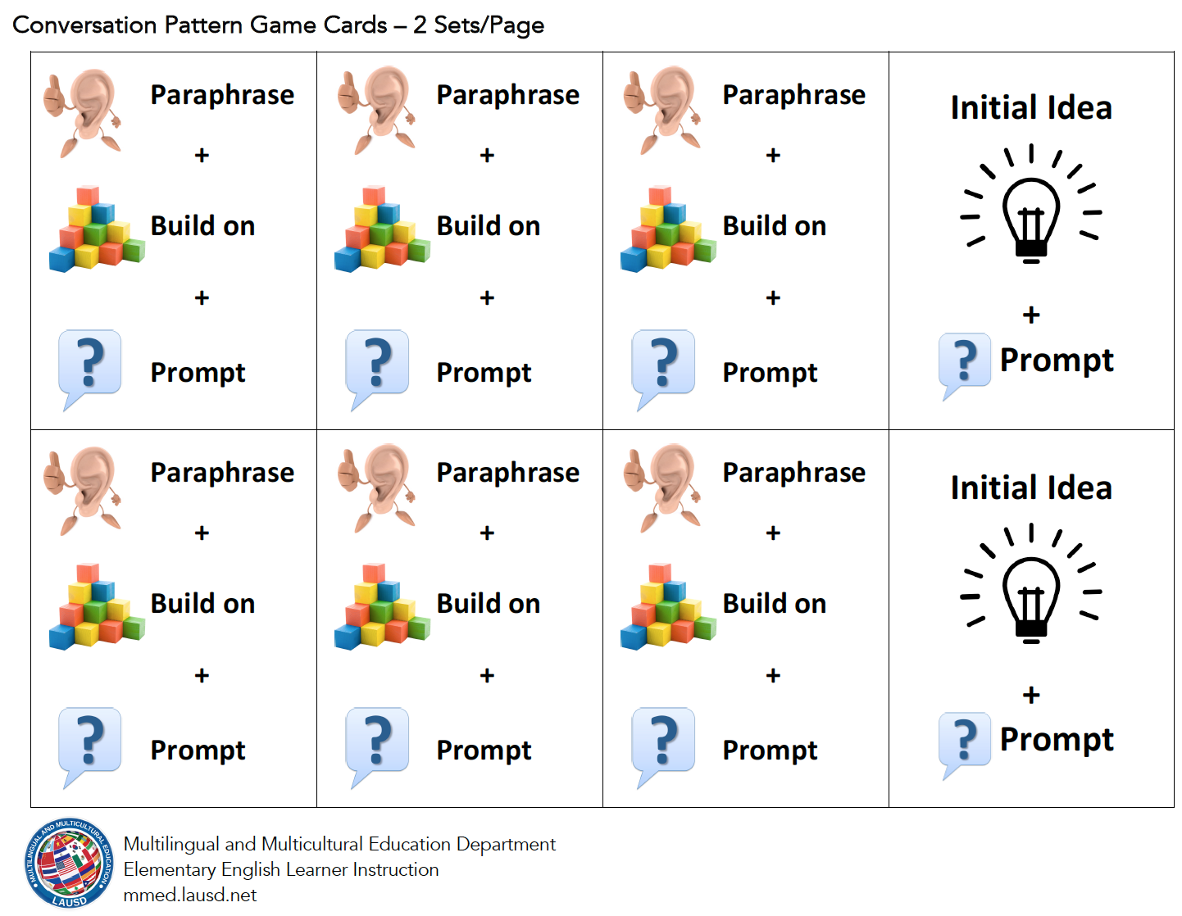
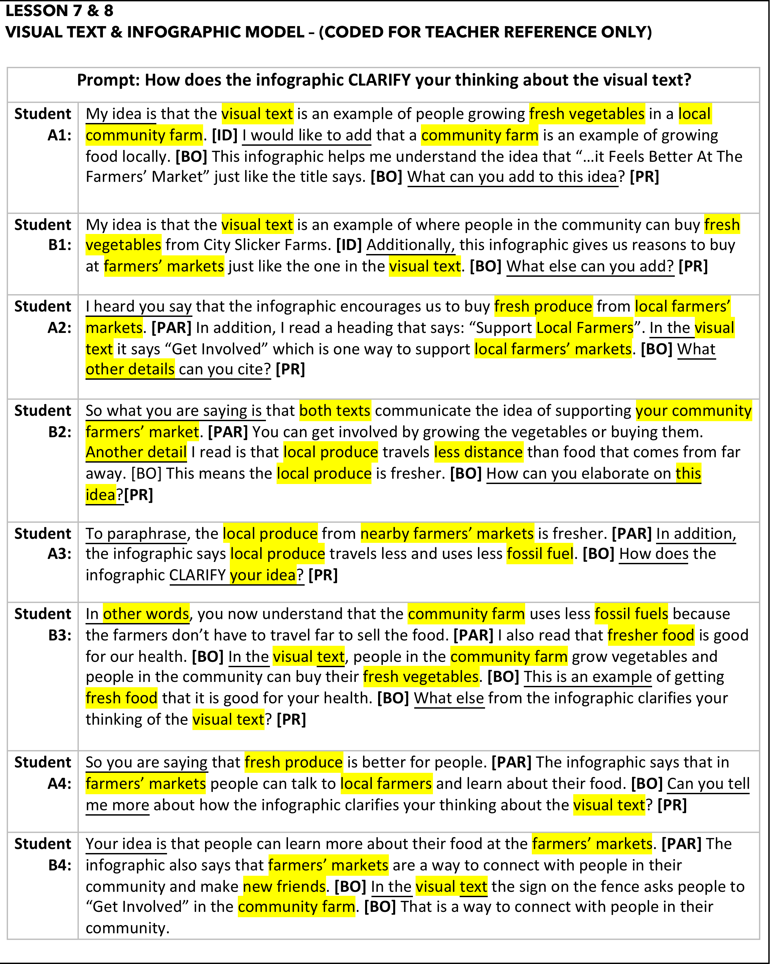
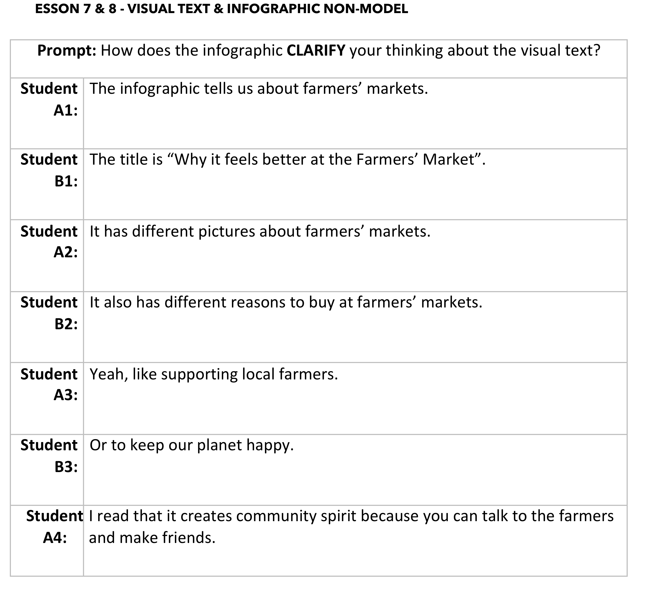
Lesson 7: Practice CREATE and CLARIFY with Both Texts

Slide 34
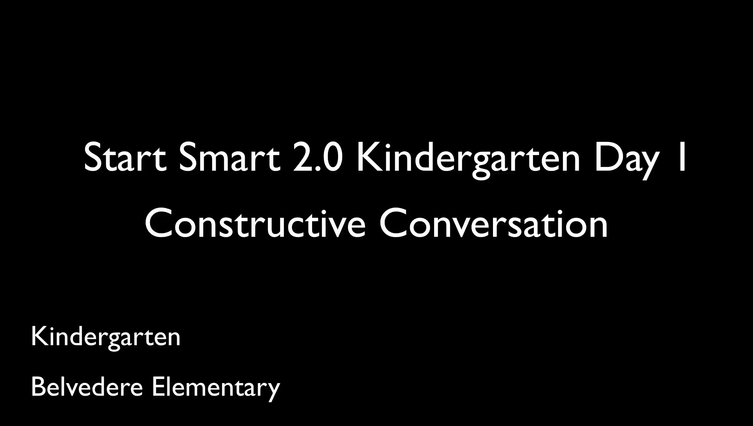
Grounding
Notes:
5 minutes
You can use this video at the beginning or ending of your pd if you are allocated more than one hour for this pd.
Teachers will listen to the language sample
Teachers can use the transcription to guide them as they listen

Slide 35
Lines of Communication
What?
Think and Reflect
How?
LINES OF COMMUNICATION:
Form two lines (Line A / Line B), each person should be facing another person in the line (everyone should have a partner)
At the signal, partners wrap up their discussion and Line A will move one position to the left. The partner at the end of Line A will move down the center aisle to find a new partner.
Be prepared to share out
Notes:
5 min. this slide
Give participants one minute to think about the two reflection questions.
LINES OF COMMUNICATION:
Stand up, form two lines, each person should be facing another person in the line (everyone should have a partner).
With your partner, answer the questions?
Think of a time when you doubted your potential? Why did you doubt yourself? What helped you overcome your doubt?
Think of ELs in your class. How have you validated what they know and built upon it?
Take one minute to hear a couple of ideas from the group.

Slide 36
Lines of Communication
Think about the following prompts:
What does it mean to listen for understanding?
What does it look/sound like for a child at the grade level you teach?
Whole Group Share Out
What are some new insights from your partner and the video?
Notes:
2 minutes on this slide
Say: Working with English Learners poses unique challenges, but as instructional leaders we face these head on. In what ways did Lucy support

